Slide 1
Calorie Calculator Using CBIR
Supervisor:
Dr. Archana Patankar
(Associate Professor, Computer Engineering Department, TSEC)
Presented by:
Group No. 10
Sagar Mistry 86
Anirudh Mundra 90
Shubham Munot 91

Slide 2
Why do you need a Calorie Calculator?
Due to improper intake and non-regulated intake of food, people deal with various health problems.
A person has to search each food item on internet to know the calorie value.
Our approach, would require an image of the raw contents of a person’s meal, and provide them with their calorie intake.

Slide 3
Existing Solution
The referred approach have implemented the below mentioned procedure to implement the system.
Food Image
Segmentation of food portions
Feature Extraction
Calorie Measurement
Support Vector Machine

Slide 4
Proposed Approach
Flow Chart
Food Image
Pre-Processing
Segmentation of food portions
Calorie Measurement
Feature Extraction

Slide 5
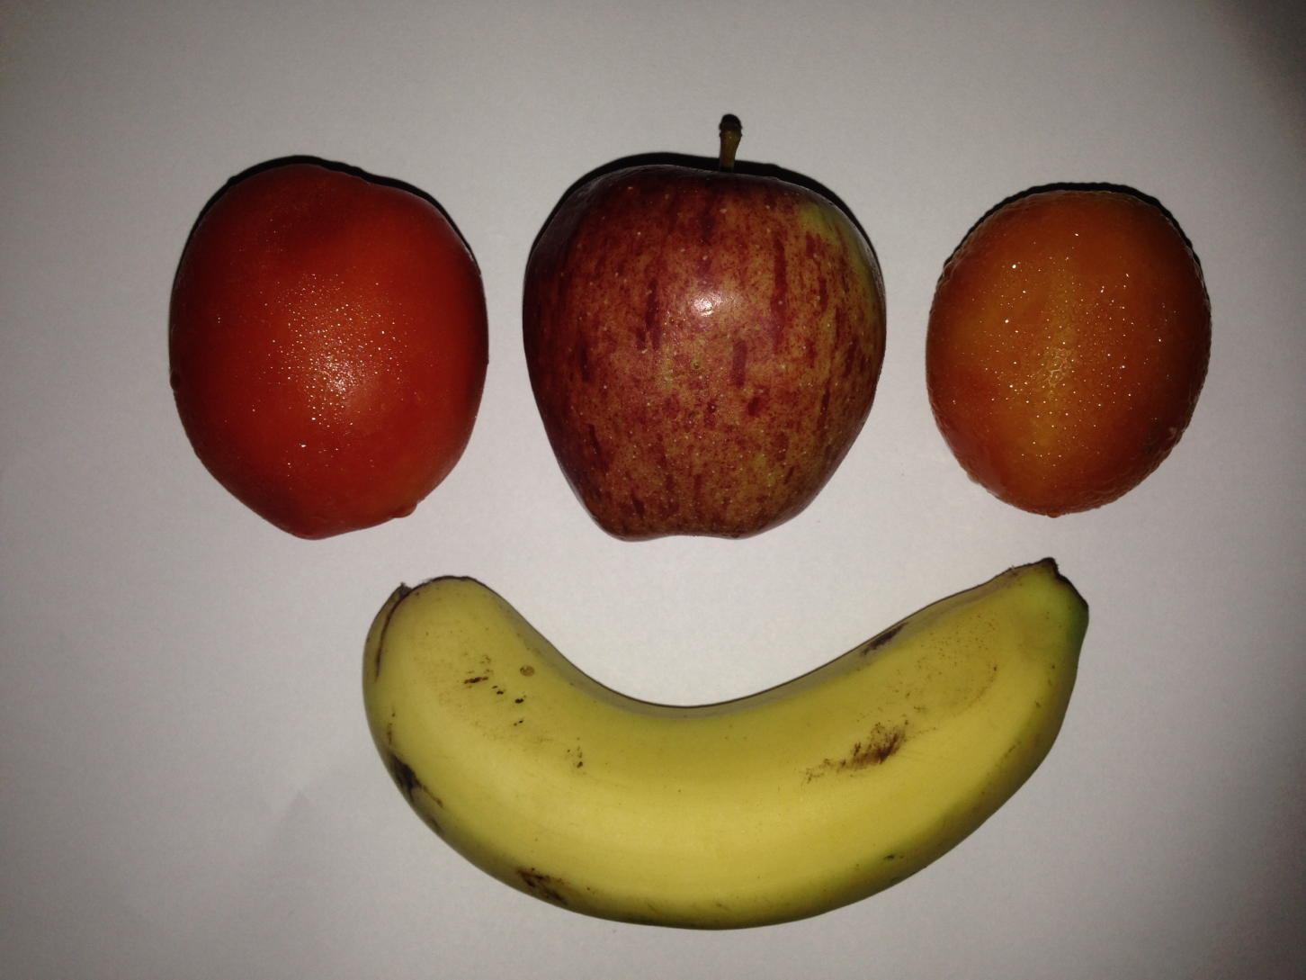
Sample Food Image

Slide 6
Pre-Processing
Noise Reduction
To reduce the unwanted noise in order to have a better image for further phases.
Shadow Removal
As we are concerned with only the food item, we intend to remove the shadow which will otherwise contribute to feature vector.

Slide 7
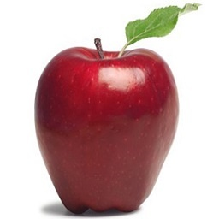
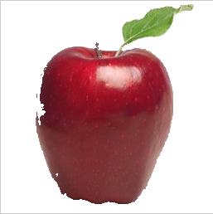
Shadow Removal
Original
Processed

Slide 8
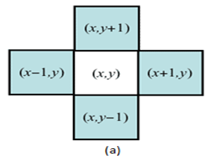
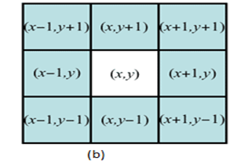
Segmentation
Replace with theory

Slide 9
Feature Extraction
Extracts feature vector of each food item segmented from the previous phase
Uses various transforms, and then computes mean feature vector of all the food items from the user image
Feature vectors of images already available in the database have been pre calculated.
Euclidean distance between the pre calculated vector and input image vector is calculated to identify the item.

Slide 10
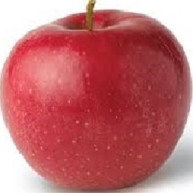
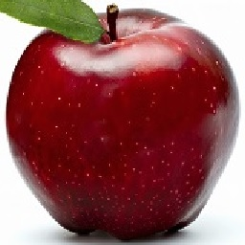


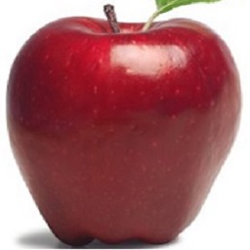
Training Images (Apple Set)
1
2
3
4
5

Slide 11
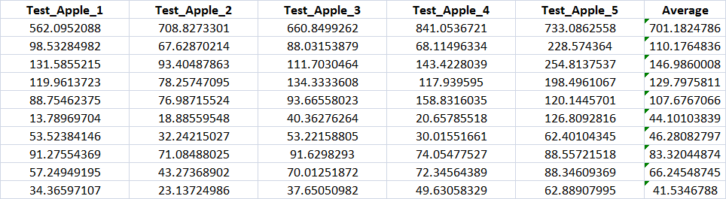
Apple Set (For Training Result)

Slide 12
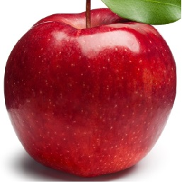
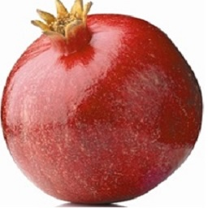
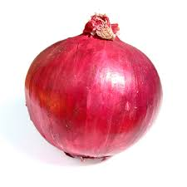
Input Images
Apple
Pomegranate
Onion

Slide 13
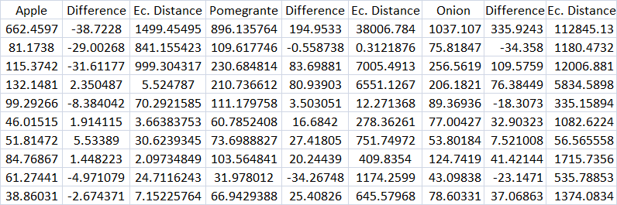
3 Input Test Images(Result)

Slide 14

Final Result(Apple WINS!!!)
Distance was calculated for apple, pomegranate and onion with the training set.
As you can see, apple has the least distance.
Hence, apple was identified successfully.

Slide 15
Calorie Computation Phase
This phase calculates the calorie for the identified food items
Maps the food items with the nutrition table to get the calorie values
Food Items | Calorie Value (in kcals)
Apple | 100
Tomato | 75
Potato | 120
Banana | 68
Bread | 56
Pomegranate | 99
Orange | 150
Green Capsicum | 60
Papaya | 55
Nutrition Table

Slide 16
Future Work
To use an object for which volume is defined universally as a calibration reference for volume measurement of food from the captured photo
One such object can be a coin, for which volume is defined universally.

Slide 17
Conclusion
To sum up we are proposing a method to identify food items using CBIR, which eloquently segments food image into different items and identifies each item.
We have provided with an accuracy matrix for feature extraction comparing different types of transforms.

Slide 18
Thank You

